Slide 1

Gold Compilers: Compiler “Foxy”
All the stages

Slide 2
Integrants:
García Felipe Miguel (Project Manager)
Felix Flores Paul Jaime ( Tester)
San Juan Aldape Diana Paola (The System Integrator)

Slide 3
How is our compiler composed?
LEXER
(Token List)
PARSER
(Abstract Syntaxt tree)
LINKER
(Assembly file)
LEXER
(Executable)

Slide 4
Lexer:
This integration will validate this:
Validate that list of tokens.
The output will be a list of atom strings tuples.
If there is an error, a list of tuples with the token will be displayed, as well as the wrong column and row.

Slide 5
Parser:
This integration will allow us to establish the following basic functionality:
Generate an AST with the list of tuples created by the Lexer.
If there is some error, it will display a list of tuples with the token generating the error, the column, and the row.

Slide 6
Code generator:
This integration will allow us to establish the following basic functionality:
Take the AST generated by the Parser to build the code in assembler, from the leaves to the root.
The output will be a string with the representative code in assembler.

Slide 7
Linker:
Linker: is a computer System program that takes one or more object files generated by a compiler or an assembler and combines them into a single executable file, library file, or another 'object' file

Slide 8
Stage one:

Slide 9
First delivery:
Compile a C source code and return a integer when executes de .exe file.
To achieve this objective, we will base ourselves on how to create a compiler according to Nora's documentation, as well as the tests that must be executed.

Slide 10
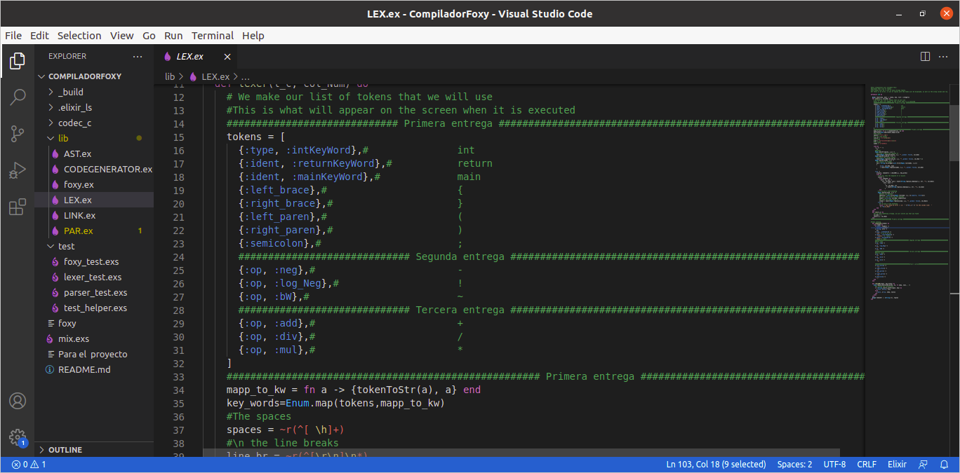
First Implentation:

Slide 11
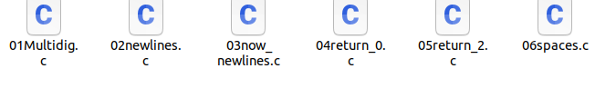
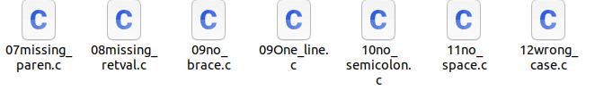
Test that the compiler must to do:
You can compile several tests that we have, if you want it in the same way, but here we will only do one
You can see the examples valid e invalids in the
folders:
Valids :
Invalids:

Slide 12
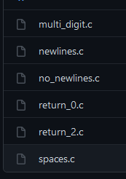

Test of Nora first stage: https://github.com/nlsandler/write_a_c_compiler/tree/master/stage_1
Valids:
Invalids:

Slide 13
Example stage one:
Valid example:
int main(){
return 2;
}
Invalid example:
int main(){
return 2
}

Slide 14
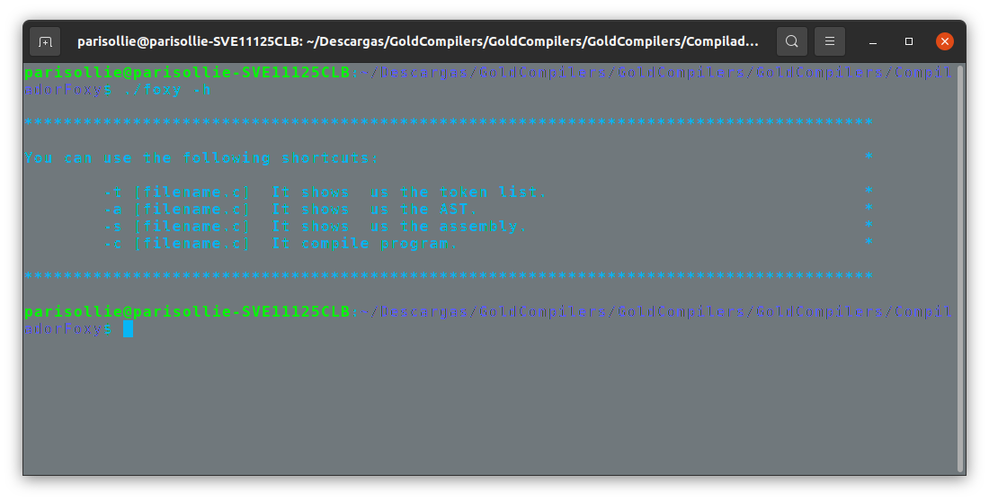
How to use the compiler Foxy with:

Slide 15
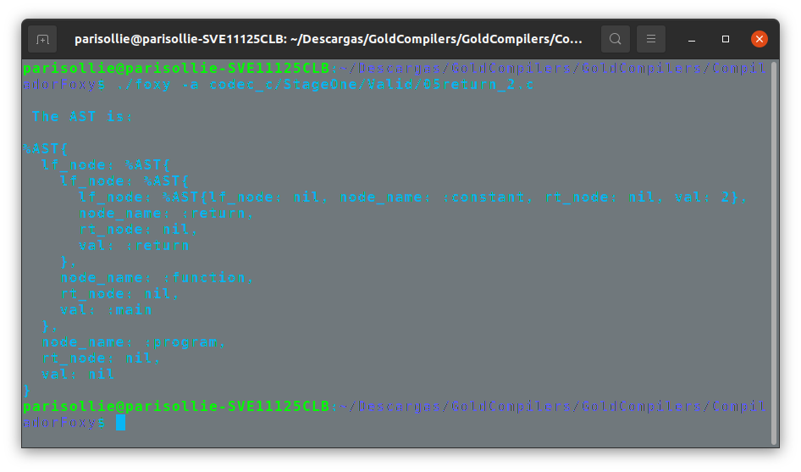
(-a)Development language must be a matching pattern to easily build an Abstract Syntax Tree (AST), however, phase I the right side’s tree must be nil.

Slide 16
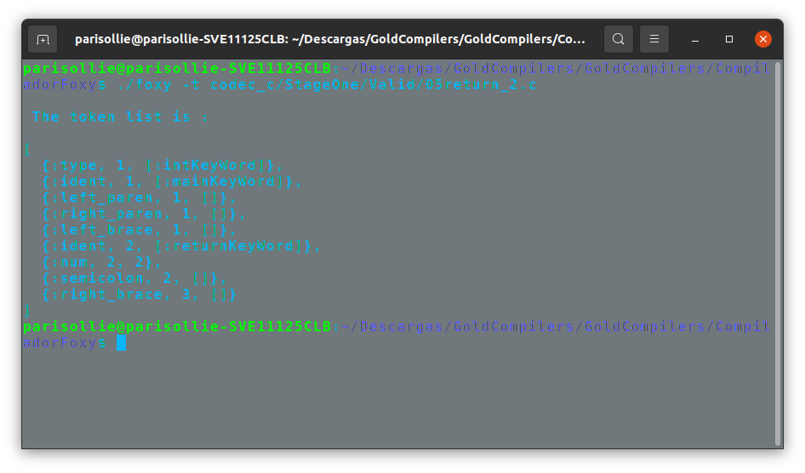
(-t)We show token’s list form source code. Must check a relational couple to recognize every token.

Slide 17
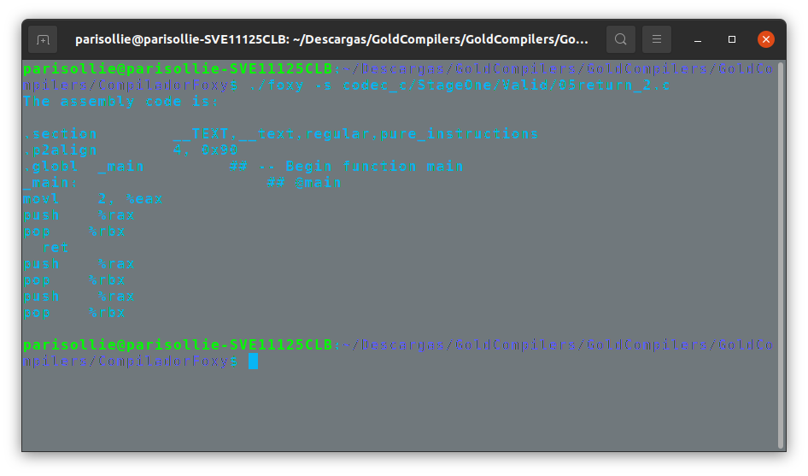
(-s)Assembly must write in 64-bits set instructions. The assembly syntax must be a AT and T by default in GCC.

Slide 18
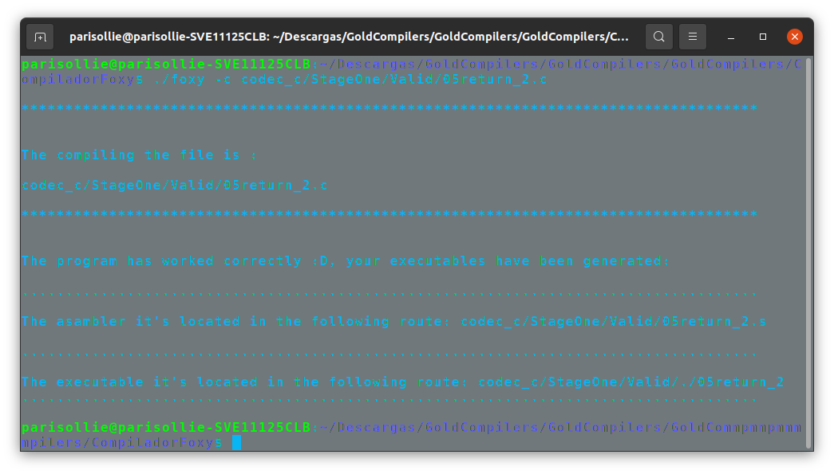
(-c) We get the assmbler and the executable:

Slide 19
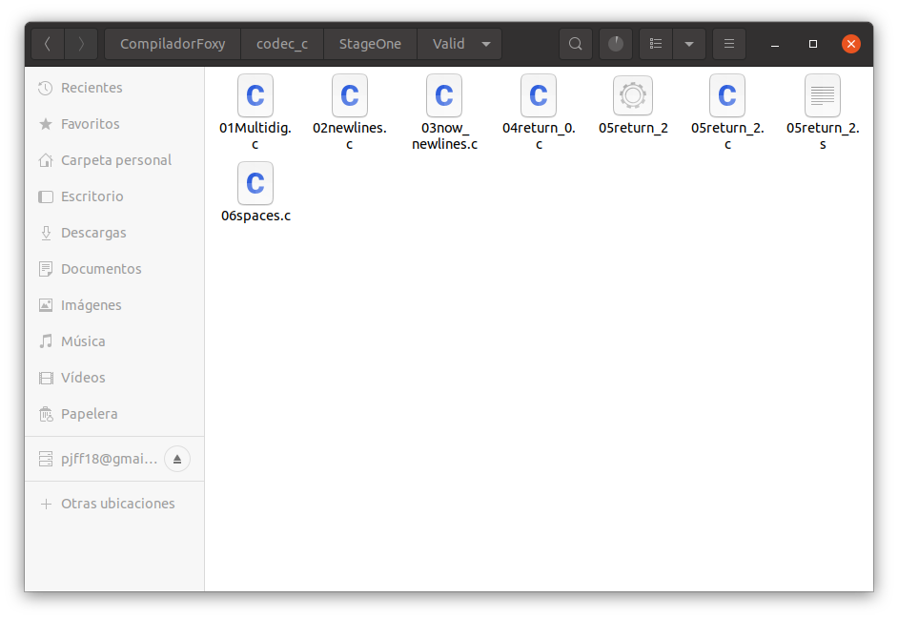
It is generated in our folder:

Slide 20
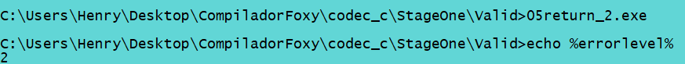
echo %errorlevel% # check the return code; it should be 2

Slide 21
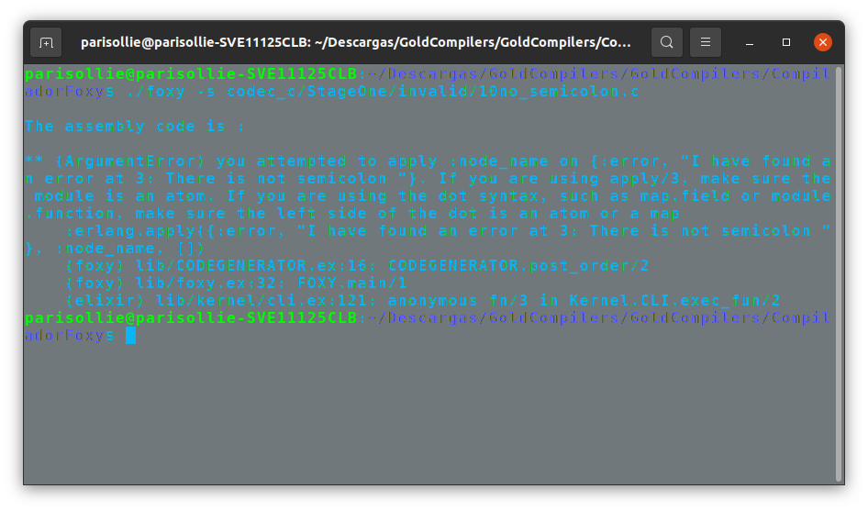
Test Invalid:

Slide 22
Stage two:

Slide 23
Second delivery:
Our compiler must can return a result operated with unary operations like negate result, positive, bitwise, and logical negation.
To achieve this objective, we will base ourselves on how to create a compiler according to Nora's documentation, as well as the tests that must be executed.

Slide 24
Second Implentation:

Slide 25
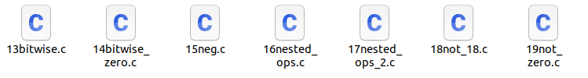
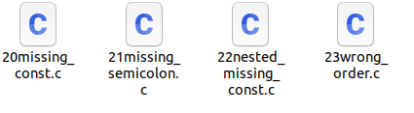
Test that the compiler must to do:
You can compile several tests that we have, if you want it in the same way, but here we will only do one
You can see the examples valid e invalids in the
folders:
Valids :
Invalids:

Slide 26

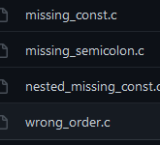
Test of Nora second stage: https://github.com/nlsandler/write_a_c_compiler/tree/master/stage_2
Valids:
Invalids:

Slide 27
Example stage two:
Valid example:
int main(){
return !17;
}
Invalid example:
int main(){
return !;
}

Slide 28
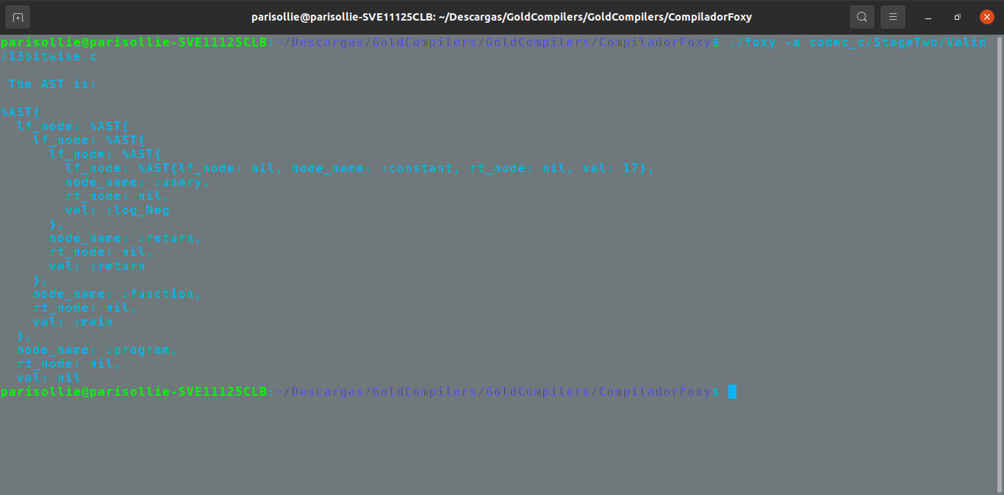
(-a)Development language must be a matching pattern to easily build an Abstract Syntax Tree (AST), however, phase I the right side’s tree must be nil.

Slide 29
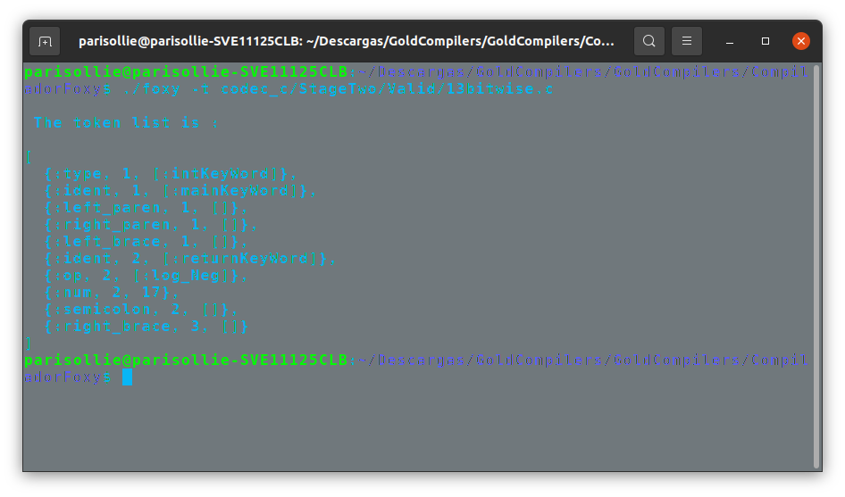
(-t)We show token’s list form source code. Must check a relational couple to recognize every token.

Slide 30
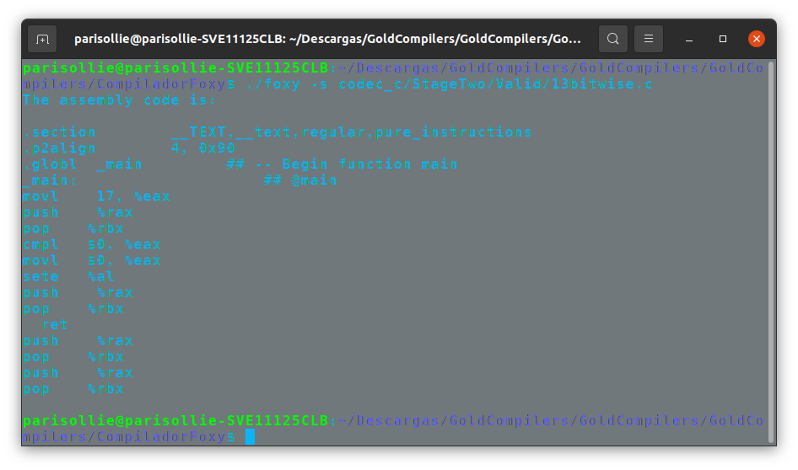
(-s)Assembly must write in 64-bits set instructions. The assembly syntax must be a AT and T by default in GCC.

Slide 31
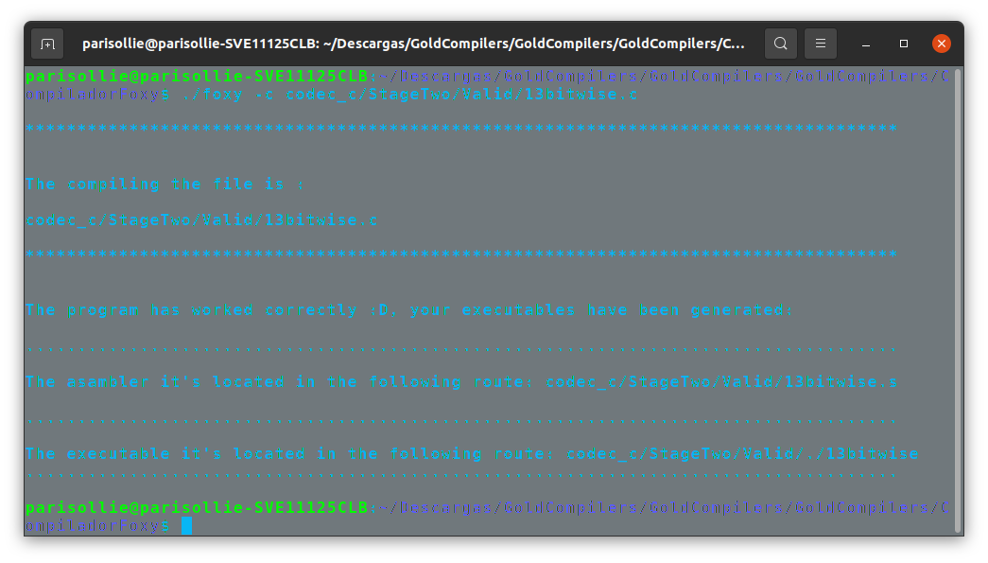
(-c) We get the assmbler and the executable:

Slide 32
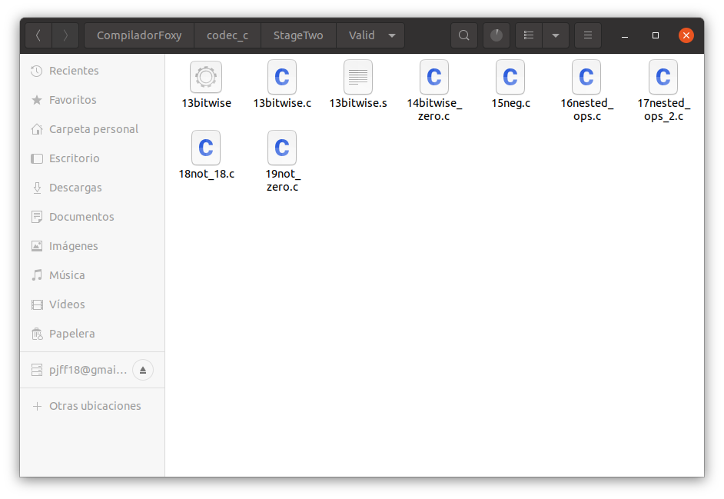
It is generated in our folder:

Slide 33
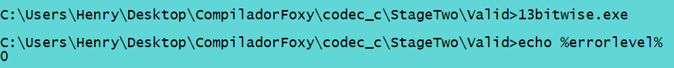
echo %errorlevel% # check the return code; it should be 0

Slide 34
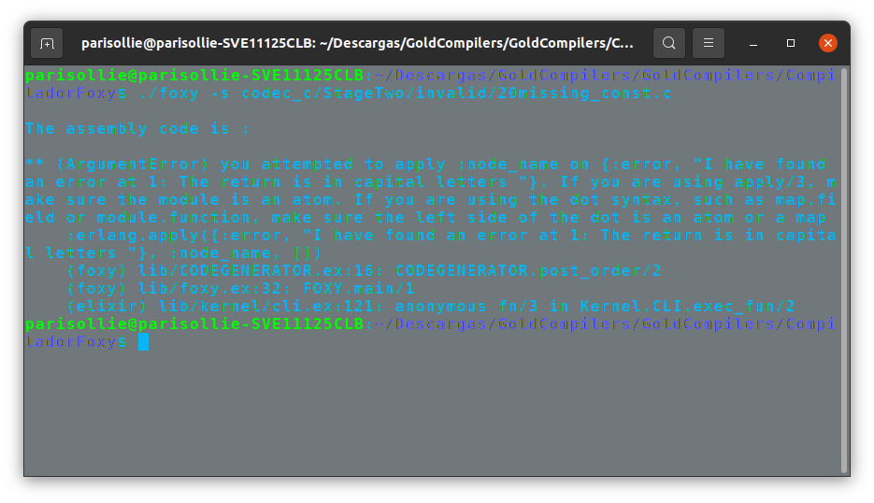
Test Invalid:

Slide 35
Stage three:

Slide 36
Third delivery:
Our compiler must can return a result operated with unary operations like negate result, positive, bitwise, and logical negation.
To achieve this objective, we will base ourselves on how to create a compiler according to Nora's documentation, as well as the tests that must be executed.

Slide 37
Third Implentation:

Slide 38
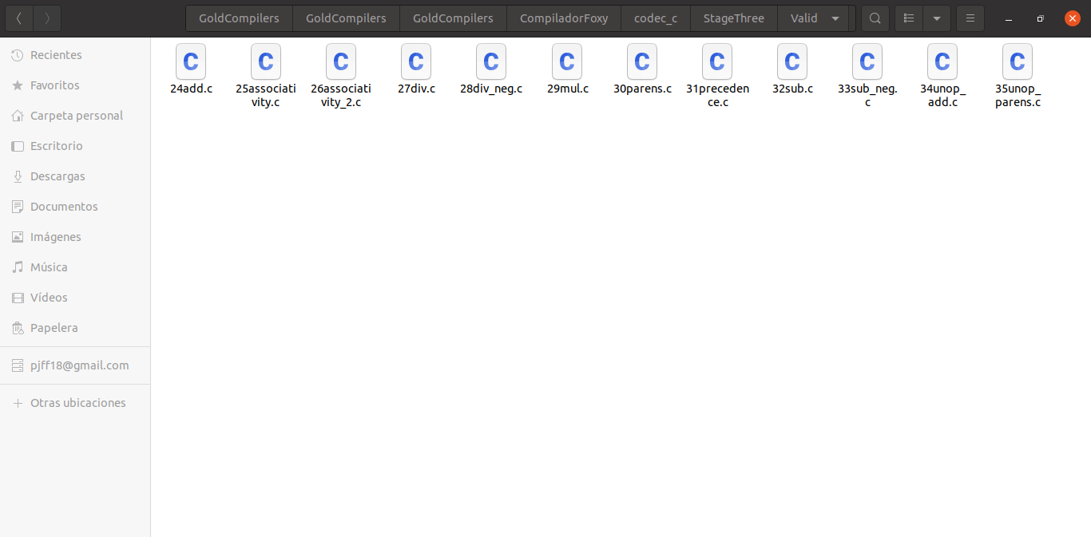

Test that the compiler must to do:
You can compile several tests that we have, if you want it in the same way, but here we will only do one
You can see the examples valid e invalids in the
folders:
Valids :
Invalids:

Slide 39
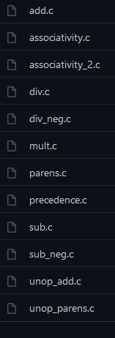

Test of Nora third stage: https://github.com/nlsandler/write_a_c_compiler/tree/master/stage_3
Valids:
Invalids:

Slide 40
Example stage three:
Valid example:
int main(){
return 2 + 2;
}
Invalid example:
int main( {
return 9 (-4);
}

Slide 41
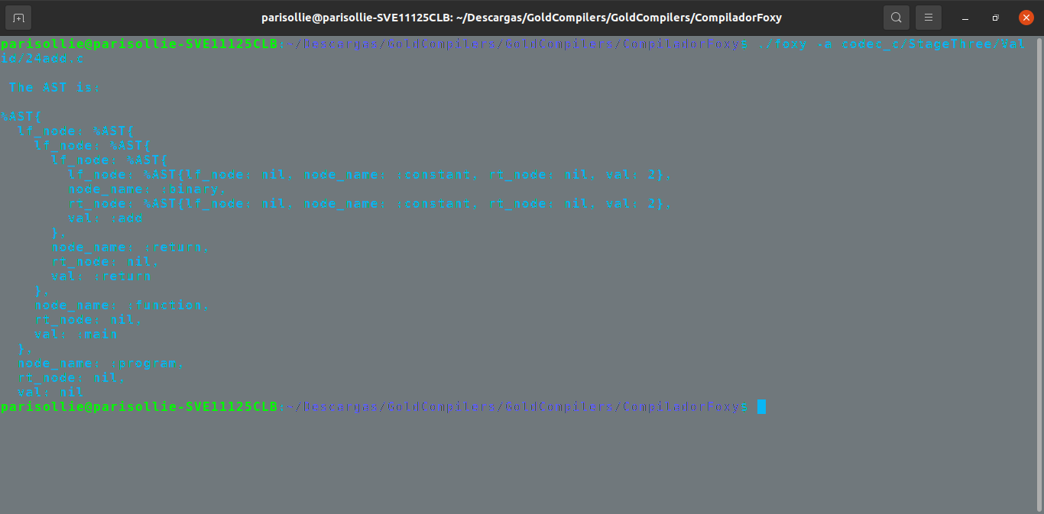
(-a)Development language must be a matching pattern to easily build an Abstract Syntax Tree (AST), however, phase I the right side’s tree must be nil.

Slide 42
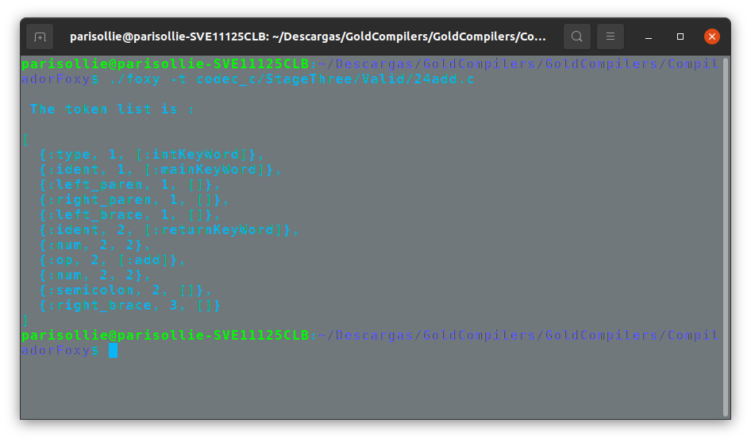
(-t)We show token’s list form source code. Must check a relational couple to recognize every token.

Slide 43
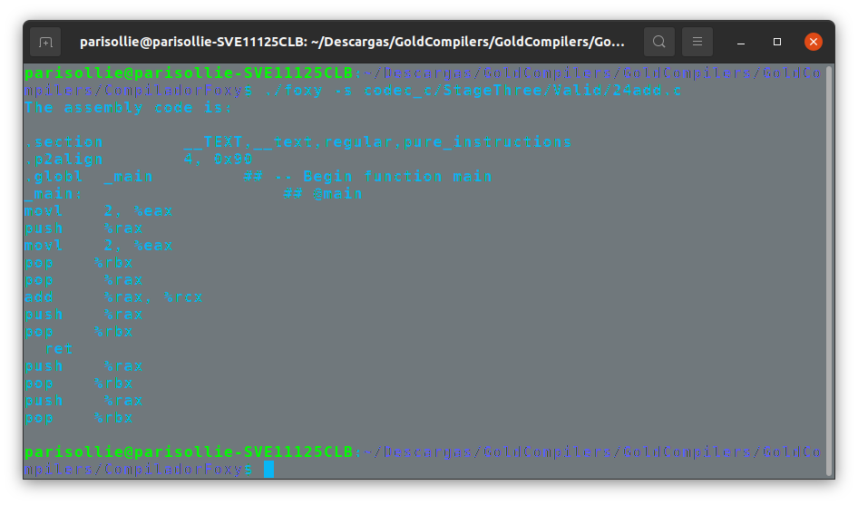
(-s)Assembly must write in 64-bits set instructions. The assembly syntax must be a AT and T by default in GCC.

Slide 44

(-c) We get the assmbler and the executable:

Slide 45
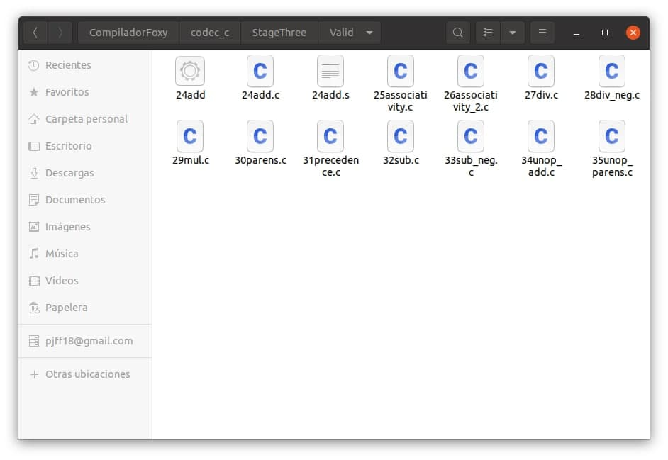
It is generated in our folder:

Slide 46
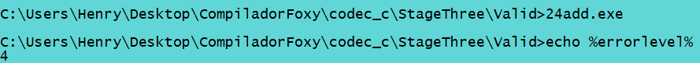
echo %errorlevel% # check the return code; it should be 4

Slide 47
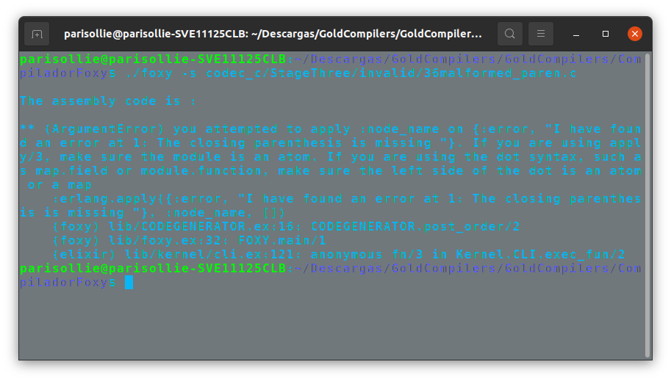
Test Invalid:

Slide 48
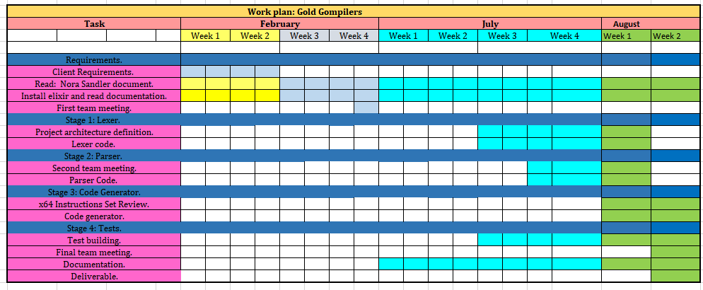
Plan work:

Slide 49
Thank you !

